Slide 1

SOFTWARE PROJECT MANAGEMENT
SHELF
BY GROUP :YY
Feed you Brain

Slide 2


GROUP
MEMBERS:
LIT2020067 Shubhankar
LIT2020068 Aman
LIT2020069 Debjyoti
LIT2020070 Kushagra
LIT2020071 Aryan
LIT2020072 Leesha
SHELF

Slide 3


ABSTRACT
Project matters that matter to all
E-commerce websites retail various lifestyle products such as clothes, electronic devices. In this project we will design and implement a simple e-commerce website for book shopping. In order to develop this site various technologies are required such as HTML and CSS.
SHELF

Slide 4


PROJECT INITIATION
Goal:- To Make an app for digital book buying and sharing.
Constraints
Start Date:- 22nd August
End Date:- 31st August
Software Requirements:-
Browser:- Safari / Chrome
Operating System:- Windows / Mac
Hardware Requirements:-
Processor:- Intel Pentium IV or above
Ram:- 512 MB or higher
Hard Disk:- At least 40 GB
SHELF

Slide 5


STAKEHOLDERS
Aryan Mogha
Shubhankar Nath
Aman Anand
Debjyoti Roy
Kushagra Singh
Leesha Labhane
(Web Developer / Main Tester / Presentation Designer)
(Web Developer)
(Presentation Designer)
(Tester / Project Lead)
(Presentation Designer)
(Web Developer)
THE WEBSITE DEVELOPMENT TEAM CONSIST OF THE FOLLOWING MEMBERS :-
SHELF

Slide 6



"WE WILL DO EVERYTHING WE CAN DO TO IMPROVE OURSELVES. WE WILL PROVIDE BEST WORK."
Creators & Founders
SHELF

Slide 7
PROJECT PLANNING
The best way to make sure you've got a killer presentation is to thoroughly prepare. Study your topic well, then create a slideshow
that will knock your classmates' socks off!
Requirements:
Research about the digital medium of marketing.
Developer Skills
Designing Skills
Content Writer
Work Distribution
Medium of Collaboration
SHELF

Slide 8
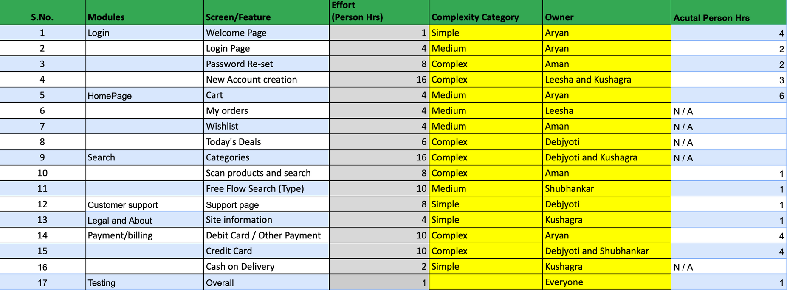

Work Breakdown Structure
SHELF

Slide 9
PROJECT EXECUTION
Start Date(22nd August)
Project Manager distribute work between all the members
23rd August - 29 August
Everbody works on the part assigned to them as displayed and explained in the following slides
30th August
The project is now finally completed and is going through the testing process.
SHELF

Slide 10
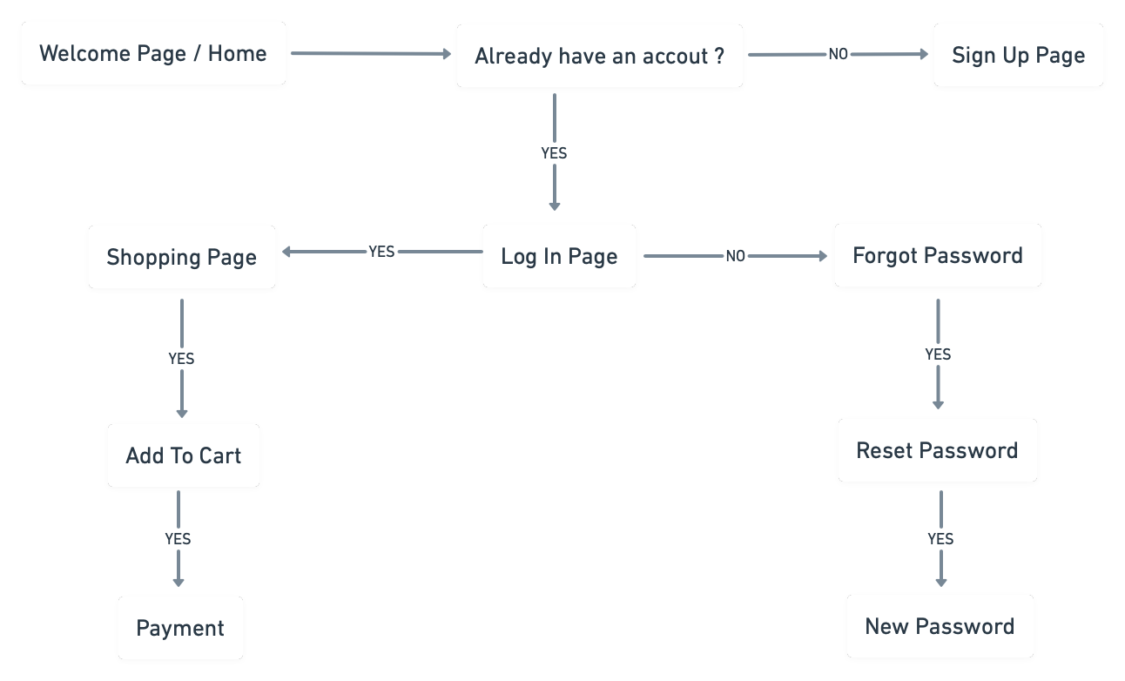
PROJECT WORKING

Slide 11




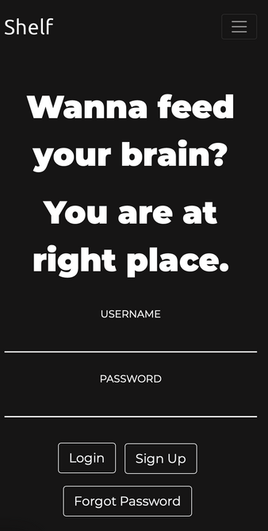
HOME / LOGIN PAGE
This is how our home page looks like on laptop and mobile. When you first land on our site, this is what you gonna see.
SHELF

Slide 12
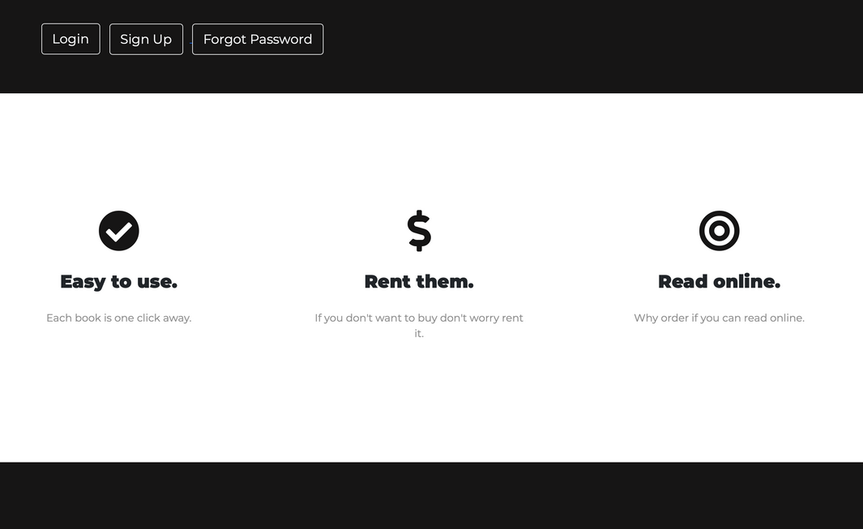
WHEN YOU SCROLL DOWN OUR HOME PAGE
This part of our homepage tells the features of our website, that how it is different from others and best for you.
SHELF

Slide 13


WHEN YOU SCROLL DOWN OUR HOME PAGE
This is our testimonial section which shows some reviews and feedback from our customers.
SHELF

Slide 14

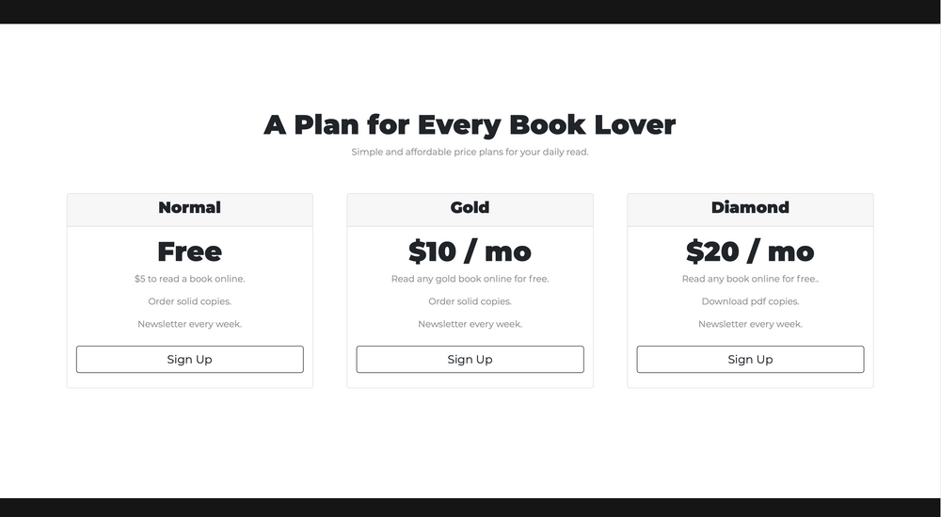
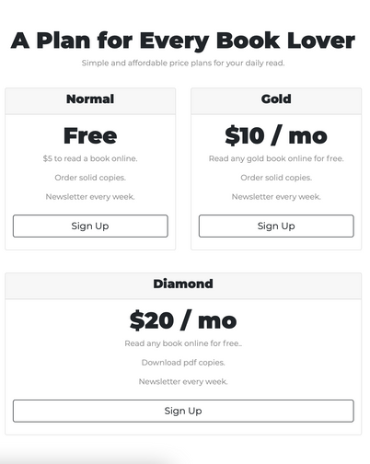
WHEN YOU SCROLL DOWN OUR HOME PAGE
This is our pricing section. This shows our plans and subscripitons for our users.
SHELF

Slide 15
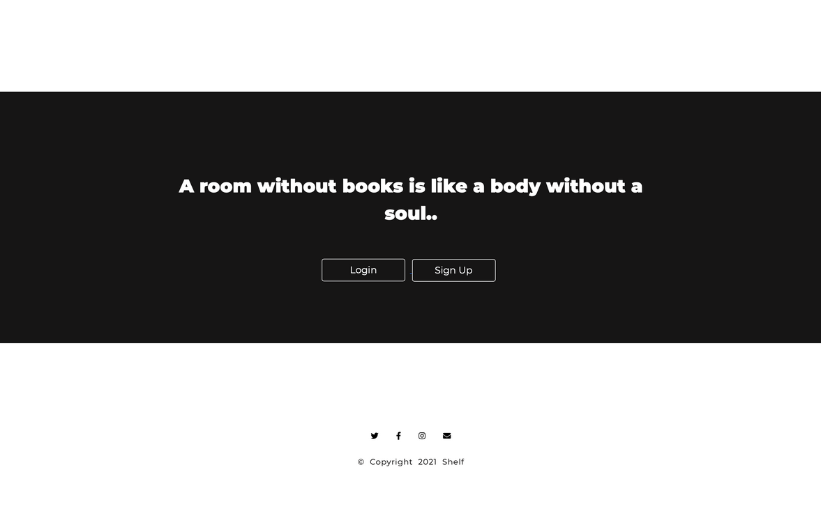
WHEN YOU SCROLL DOWN OUR HOME PAGE
And at last, you gonna see beautiful quotes and buttons which redirect the visitor to the login/sign up window at the top part of the site and at the bottom there is a connect section from which you can connect or contact us
SHELF

Slide 16
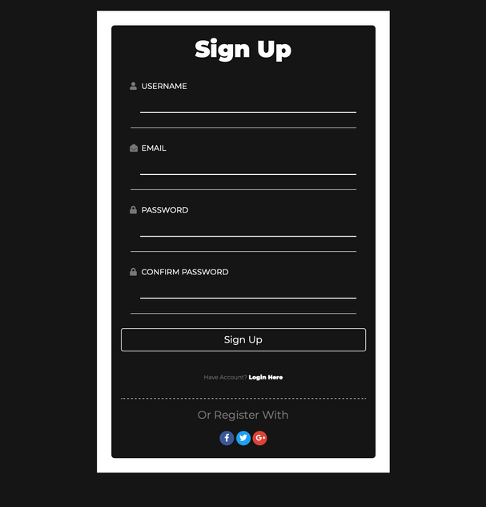

SIGN UP WINDOW OF
OUR SITE
After taping on the sign-up button you will gonna land on this web page.
SHELF

Slide 17
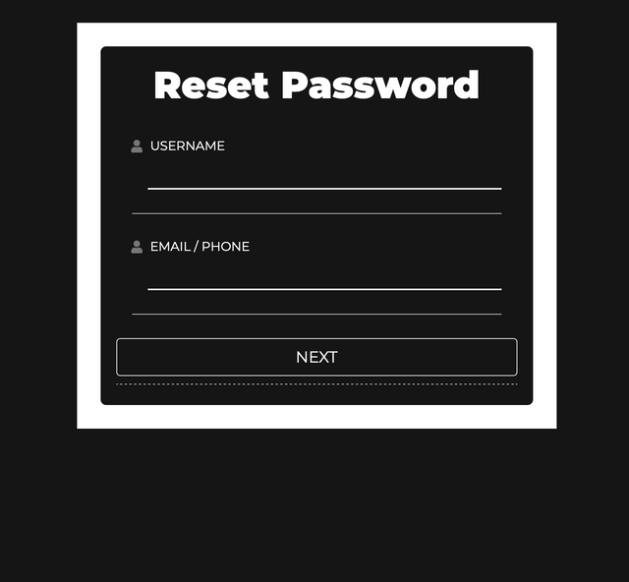
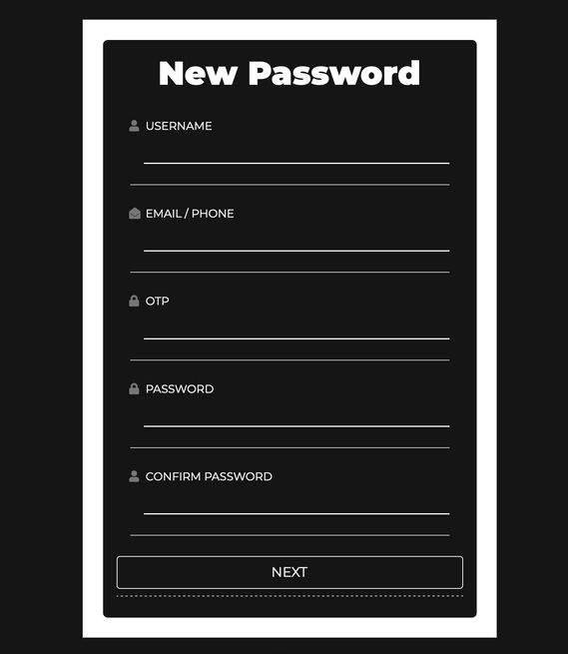
RESET PASSWARD WINDOW
If you have an account with us and you click on forget the password you gonna land on reset password page and after clicking on next you will reach at new password page.
SHELF

Slide 18
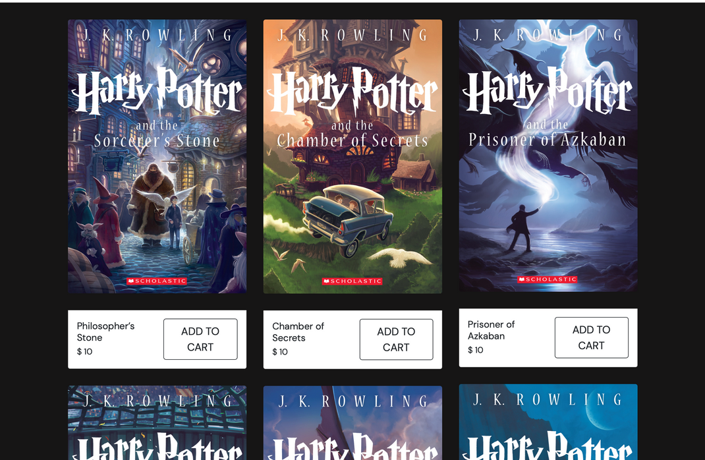

LISTED ITEMS IN OUR STORES
After logging in to our site you will going to land on this page where all of our products are listed on our store and from here you can add products in the cart.
SHELF

Slide 19
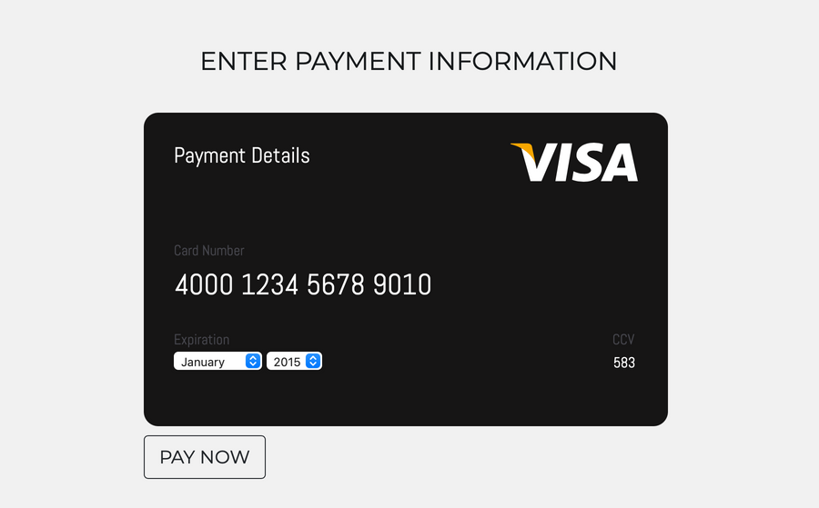
THIS IS OUR
PAYMENT PAGE
You need to add your payment details to the card and
then click on pay now.
SHELF

Slide 20
SUPPORT YOU
CAN COUNT ON
Flexible working hours
Presentations are communication tools that can be used as demonstrations, lectures, speeches, reports, and more.
Paid medical leave
Presentations are communication tools that can be used as demonstrations, lectures, speeches, reports, and more.
Weekly salary release
Presentations are communication tools that can be used as demonstrations, lectures, speeches, reports, and more.
SHELF

Slide 21
PROJECT
CLOSURE
More defined roles and responsibilities.
More rigorous testing when code is moved to staging and another environment.
Hold project meetings only 1-2 days per week and refrain from scheduling outside of this window. This provides a block of quality work time for the project team.
SHELF

